Slide 1

Computer Architecture
Convolution Algorithm
Francesco Bruno
Matteo Halilaga

Slide 2


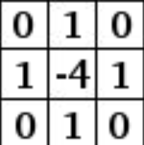
Introduction of Convolutional Algorithm
The Convolution Algorithm is typically used in Convolutional Neural Network, for example in digital image processing, like features extraction.

Slide 3
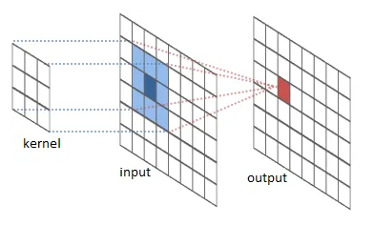
Introduction of Convolutional Algorithm
The convolution consists of sliding a filter (also called kernel) across an input image
Common Image Resolution
 | SD | 2K | 4K | 8K
Resolution | 720x576 | 2048x1080 | 4096x2160 | 7680x4320

Slide 4
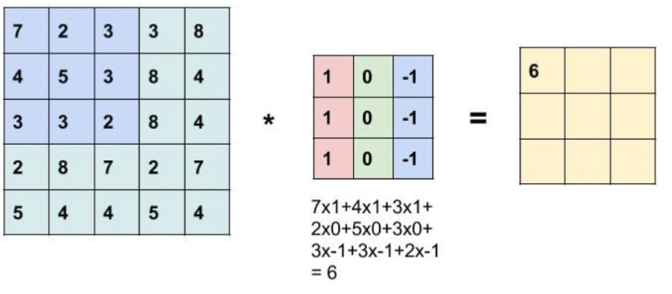
How the Convolution Algorithm works? (1/3)
Input matrix
Kernel
Output matrix

Slide 5
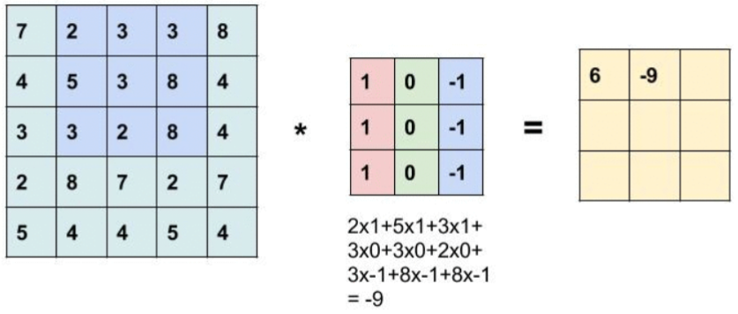
How the Convolution Algorithm works? (2/3)
Input matrix
Kernel
Output matrix

Slide 6
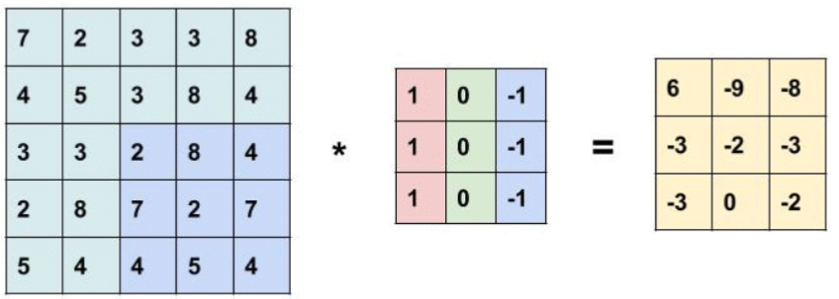
How the Convolution Algorithm works? (3/3)
Input matrix
Kernel
Output matrix

Slide 7

Hardware Specifics
INTEL® Core ™ i5 10210U
Platform : Laptop
Cpu Cores : 4
Base Clock Frequency : 1,6 GHz
Architecture Family: Comet Lake
Hardware Threads: 8
Max Clock Frequency : 4,2 GHz
L1 Cache: 256KB
L2 Cache: 1MB
L3 Cache: 8MB

Slide 8
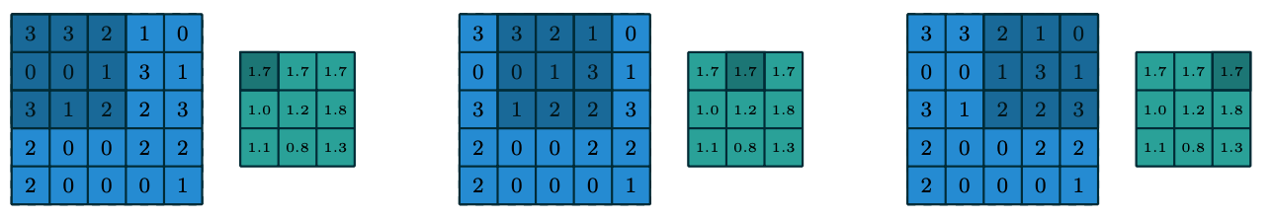
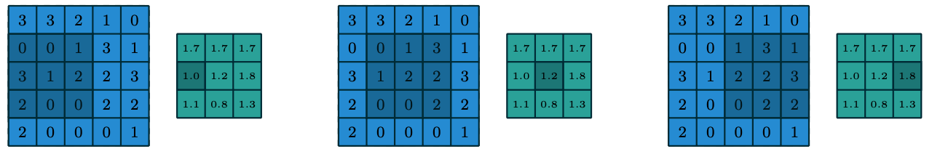
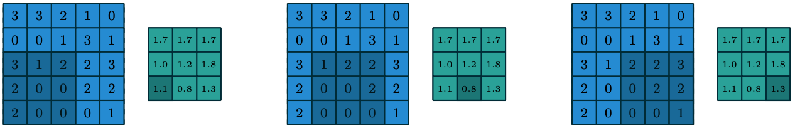
How to Parallelize it? The Idea
T1
T2
T3

Slide 9
Performance Analysis
SD: 720x576
2K: 2048x1080
4K: 4096x2160
8K: 7680x4320

Slide 10
Performance Analysis

Slide 11
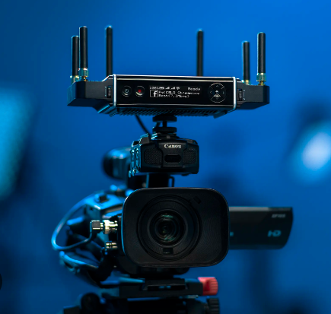
Goal
We suppose our application is involved in apply filter on a real time video. Our 0bjective is, given a source at 6O fps, to calculate the convolution before the arriving of the next frame
60 fps → 1/60 = 16ms
So for each image resolution, the execution time should be less than 16ms

Slide 12
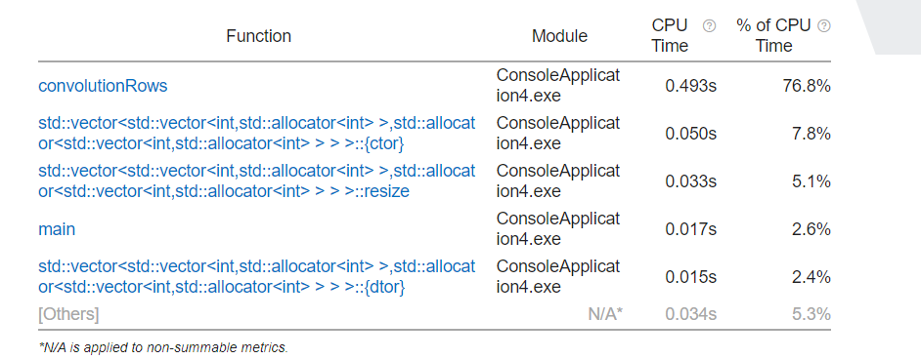
Bottleneck analysis using VTUNE

Slide 13
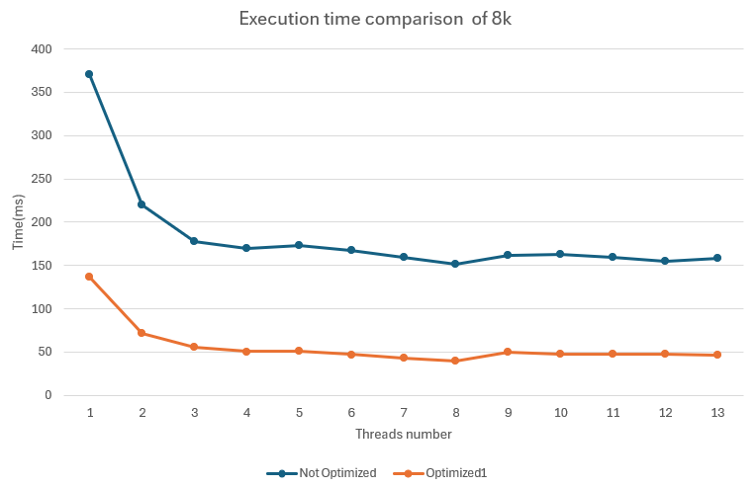
Optimization 1/2
avoid the usage of the STL library declaring vector and matrix manually
increase data locality avoiding:
Eliminating variable redundancy
Restructuring the code to allow the compiler to do some optimization

Slide 14
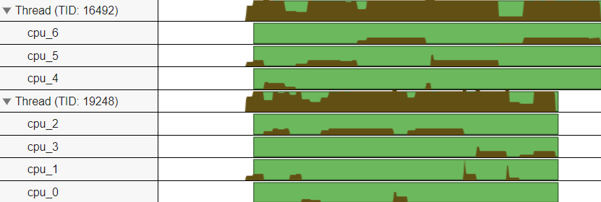
Optimization 2/2
Analyzing the data of the profiler we see:
all threads are bounced between the various cores degrading performance.
SOLUTION: using the Affinity to force each thread to run on the same core to have more probability that its image in cache remains intact

Slide 15
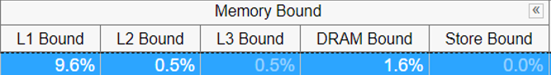
Comparison
Opt1
Opt with Affinity

Slide 16
SpeedUp Analysis 1/2

Slide 17
Scalability Analysis 2/2

Slide 18
Conclusion
We reached our goal only for the SD, 2K and 4K image format.
For the 8k we have a 36ms time execution instead of 16ms (our target).
Let’s discover if the GPU is capable to do better…

Slide 19
GPU IMPLEMENTATION

Slide 20

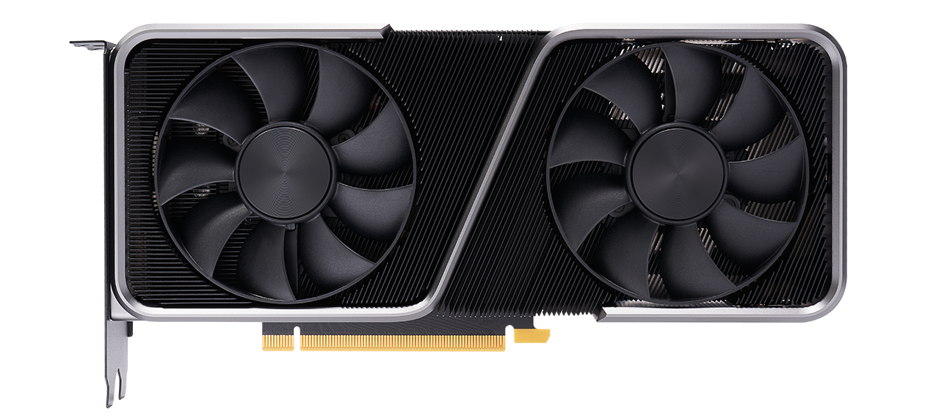
Hardware Specifics
SPECIFICATIONS
GPU Architecture | Ampere
Global Memory | 8192 MBytes
40 multiprocessor, 128 cuda core/MP | 5120 cuda cores
Constant Memory | 65536 bytes
Shared Memory per block | 49152 bytes
Shared Memory per MP | 102400 bytes
Number of registers per block | 65536
Warp Size | 32
Maximum number of thread per MP | 1536
Maximum number of thread per block | 1024
Maximum dimension size of a thread block | (1024, 1024, 64)
Maximum dimension size of a grid size | (2147483647, 65535,65535)

Slide 21
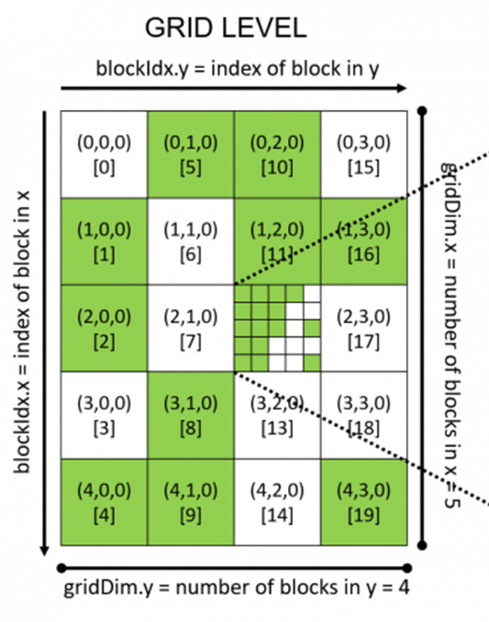
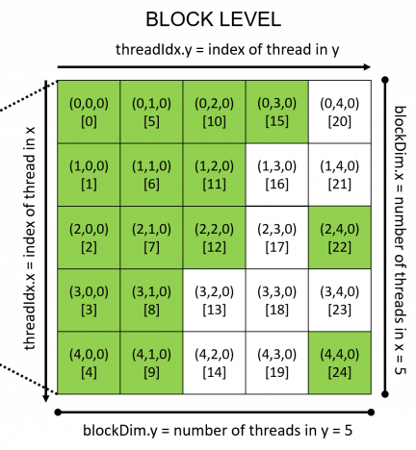
Bidimensional Grid and Blocks
Total Threads: 500

Slide 22
How to go in parallel with GPU?
Output Matrix Example (14x14)
 | IDcol
IDrow | 0,0 | 0,1 | 0,2 | . | . | . | . | . | . | . | . | . | . | 13,0
 | 1,0 | 1,1 | 1,2 | . | . | . | . | . | . | . | . | . | . | 13,1
 | . |  |  |  |  |  |  |  |  |  |  |  |  | .
 | . |  |  |  |  |  |  |  |  |  |  |  |  | .
 | . |  |  |  |  |  |  |  |  |  |  |  |  | .
 | . |  |  |  |  |  |  |  |  |  |  |  |  | .
 | . |  |  |  |  |  |  |  |  |  |  |  |  | .
 | . |  |  |  |  |  |  |  |  |  |  |  |  | .
 | . |  |  |  |  |  |  |  |  |  |  |  |  | .
 | . |  |  |  |  |  |  |  |  |  |  |  |  | .
 | . |  |  |  |  |  |  |  |  |  |  |  |  | .
 | . |  |  |  |  |  |  |  |  |  |  |  |  | .
 | . |  |  |  |  |  |  |  |  |  |  |  |  | .
 | 13,0 | 13,1 | 13,2 | . | . | . | . | . | . | . | . | . | . | 13,13
Exploit the bidimensional architecture to have: one thread per output matrix element
We compute the thread id on each axis like:
The total threads number is constantly equal to the output matrix size

Slide 23
Performance Analysis 1/2
CPU 8 threads
GPU Threads per block: (32,32)

Slide 24
Performance analysis 2/2

Slide 25
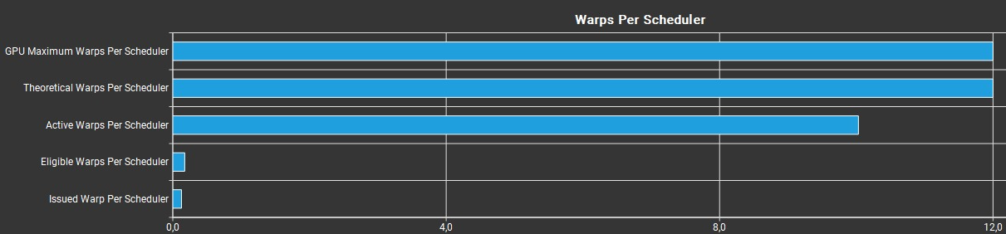
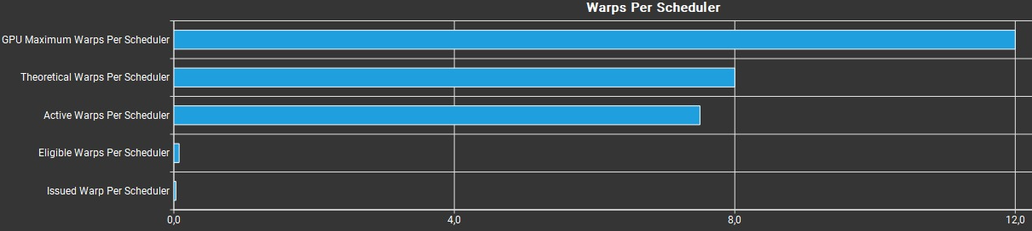
Nsight Compute Analysis
version 2x128
version 2x512

Slide 26
Optimization 1/2
To reduce the conflicts in cache and exploit faster memory, we decide to relocate the kernel matrix in the Constant Memory and the input matrix and output matrix in the Shared Memory
Since the profiler reavealed high latency due to the cudaMemcpy and the trasfering of the data, we decide to parallelized the computation and the trasfer by dividing the input matrix in 4 blocks.

Slide 27
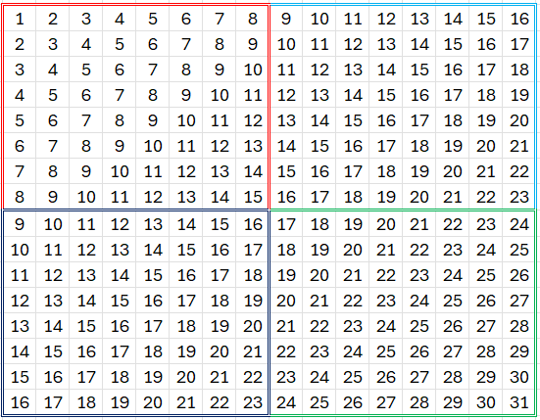
Optimization 2/2
Key Idea: Parallel computation with asynchronous data transfer
The red sub-matrix is convoluted by the kernel while the light-blue one is transfered in Shared Memory

Slide 28
Comparison

Slide 29
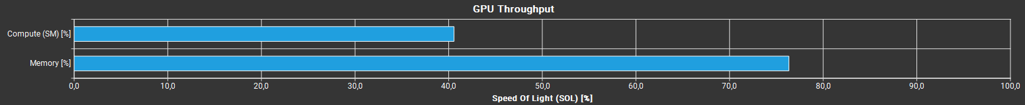
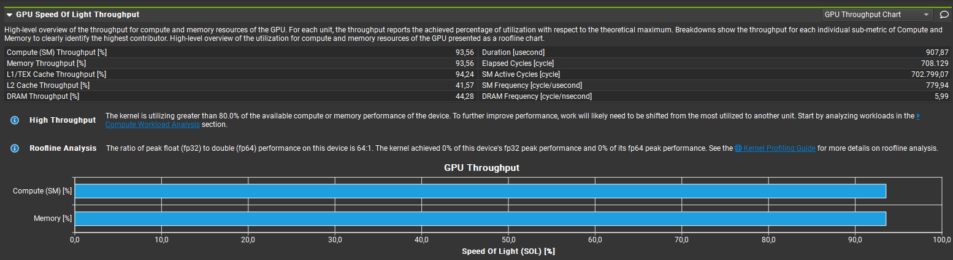
Nsight Compute Analysis

Slide 30
Workload Analysis

Slide 31
Conclusion
Target achieved: 0.627ms
The best performance is not necessarily achieved by selecting the configuration with the maximum number of threads
The configuration with 256 threads provides the best performance
For our algorithm, the GPU architecture is excellently exploited due to its high level of parallelism

Slide 32
THANKS FOR YOUR ATTENCTION

